Slide 1
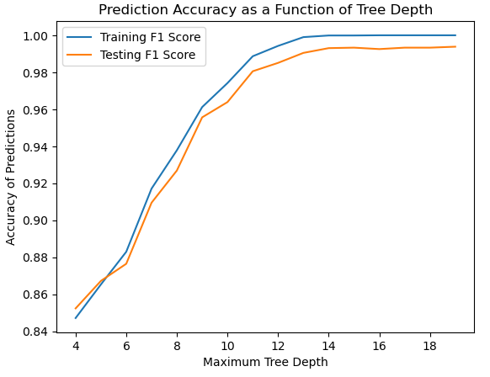
3. Imputation Testing – Decision Tree
Nursery Dataset
Base Train
10% missing values
40% missing values
Base Test
70% Missing Values
Naïve Bayes Imputation
Naïve Bayes Imputation
Naïve Bayes Imputation
Mode Imputation
Mode Imputation
Mode Imputation
Notes:
Hi, I am Sarel Vermaak.
Now that we have a base dataset and datasets with induced and imputed missing values, we can validate the performance of the imputation techniques by running classification models on each dataset and comparing the performance of each dataset.
I will present a decision tree classifier that was used as the first validation model.
We used the base model before missing values were induced as a control. The base dataset was split into a test and train dataset, and these were used to determine the maximum tree depth hyperparameter for the decision tree. This was done by running the model for various tree depth values, measuring the weighted F1 score across prediction classes for the training and testing set. This metric is used as a measure of error in the model, and the optimal point is there the testing F1 score either stabilizes or decreases.

Slide 2
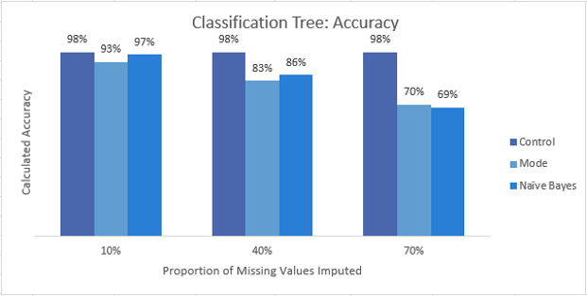
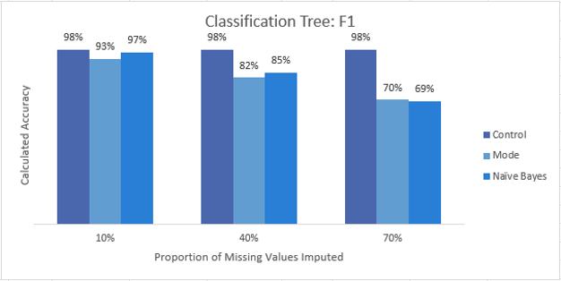
3. Imputation Testing – Decision Tree
Nursery Dataset
Base Train
10% missing values
40% missing values
Base Test
70% Missing Values
Naïve Bayes Imputation
Naïve Bayes Imputation
Naïve Bayes Imputation
Mode Imputation
Mode Imputation
Mode Imputation
Notes:
The model with optimal hyperparameters was then trained across the various datasets, and the accuracy and weighted F1 scores were computed for each based on predictions made against the base test table.
In this process we calculated control metrics using the base training and testing set. This base value is then compared against the mode and Naïve Bayes imputation techniques at three different levels of missing values induced on the base dataset, 10%, 40%, and 70%.
From this we can see that the classification performance declines as the number of missing values increases as expected, and surprisingly enough the Naïve Bayes and Mode imputation techniques created datasets that performed very similarly at all levels.

